Slide 1
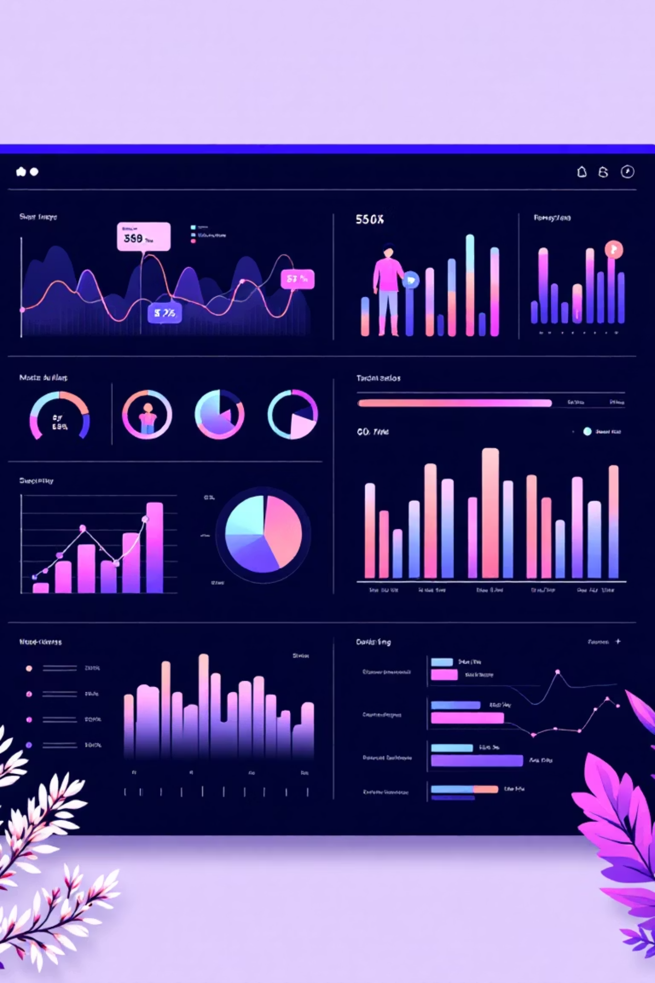
Customer Shopping Behavior Analysis
Analyzing 3,900 customer transactions to uncover spending patterns, preferences, and strategic opportunities for business growth.

Slide 2

Dataset Overview
3,900
18
$59.76
Total Purchases
Data Points
Avg Purchase
Transactions analyzed across all categories
Features covering demographics and behavior
Mean transaction value per customer
3.75
Avg Rating
Customer satisfaction score
Dataset includes customer demographics, purchase details, shopping behavior, and subscription status across 50 locations.

Slide 3

Data Preparation & Cleaning
Python Analysis Steps
Loaded dataset using pandas
Explored structure with df.info() and .describe()
Imputed 37 missing Review Rating values using category medians
Standardized columns to snake_case
Created age_group and purchase_frequency_days features
Dropped redundant promo_code_used column
Connected Python to PostgreSQL and loaded cleaned data for structured SQL analysis.

Slide 4

Revenue Insights by Gender
Male Customers
Female Customers
$157,890 total revenue
$75,191 total revenue
68% of total revenue generated
32% of total revenue generated
Male customers contribute more than double the revenue of female customers, suggesting opportunities for targeted marketing strategies.

Slide 5

Discount Strategy Analysis
High-Spending Discount Users
839 customers used discounts but still spent above the $59.76 average purchase amount.
Top Discount-Dependent Products
Hat (50% discount rate)
Sneakers (49.66%)
Coat (49.07%)
Sweater (48.17%)
Pants (47.37%)

Slide 6
Product Performance Leaders
1
2
3
Gloves
Sandals
Boots
Highest average rating: 3.86 stars
Second highest rating: 3.84 stars
Third highest rating: 3.82 stars
4
5
Hat
Skirt
Fourth highest rating: 3.80 stars
Fifth highest rating: 3.78 stars

Slide 7




Customer Segmentation
New (83)
Returning (701)
Loyal (3,116)
80% of customers are classified as Loyal, demonstrating strong retention. Focus on converting New and Returning customers into the Loyal segment.

Slide 8
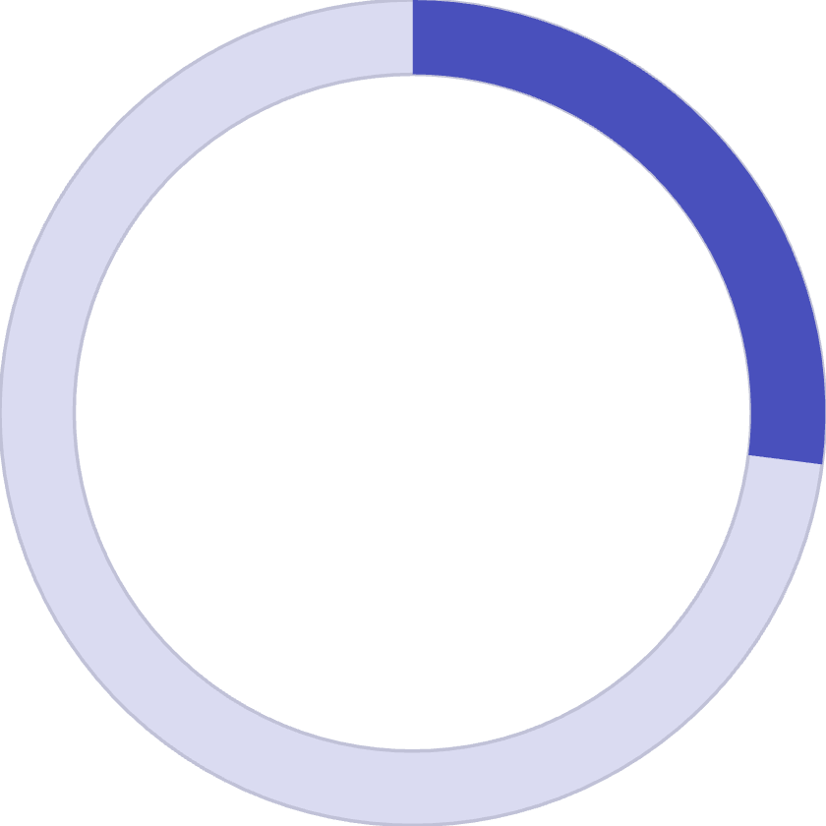

Subscription vs. Non-Subscription
27%
73%
Subscribers
Non-Subscribers
1,053 customers with $59.49 avg spend
2,847 customers with $59.87 avg spend
Key Finding: Subscribers and non-subscribers have similar average spending, but subscribers represent only 27% of the customer base.
Repeat Buyers: Among customers with 5+ purchases, 958 are subscribers while 2,518 are not—indicating subscription growth potential.

Slide 9
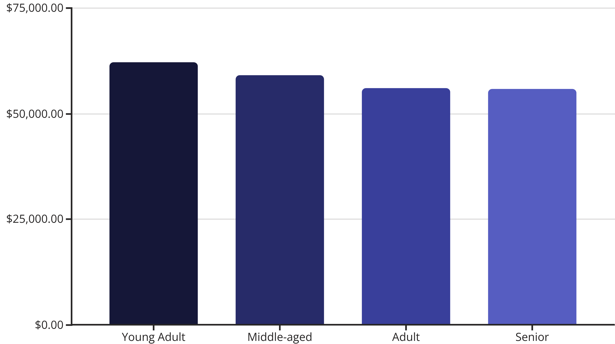
Revenue by Age Group
Young Adults generate the highest revenue at $62,143, followed closely by Middle-aged customers. Revenue is relatively balanced across all age groups.

Slide 10

Strategic Recommendations
Boost Subscriptions
Promote exclusive benefits to convert the 73% non-subscriber base into loyal subscribers.
Loyalty Programs
Reward repeat buyers to accelerate movement into the Loyal customer segment.
Review Discounts
Balance promotional sales boosts with margin control, especially for high-discount products.
Targeted Marketing
Focus campaigns on high-revenue age groups and highlight top-rated products like Gloves and Sandals.

